Slide 1
CSI 4133 Final Presentation
Aiden Stevenson Bradwell
November 28th, 2021
300064655 || abrad060@uottawa.ca
University of Ottawa, Ottawa, Ontario

Slide 2
Part B: Hand Tracking
Goal: Tracking markerless hand in a video by using object detection and object tracking.

Slide 3
External Code
https://techvidvan.com/tutorials/hand-gesture-recognition-tensorflow-opencv/
Provided pretrained hand-recognition TensorFlow network, implemented through Google Mediapipe
Taken network
Taken stages to get network to return hand bone locations
No author information available
No git information available.

Slide 4
Method Steps
Input video and output video handlers
Initialize 2 empty lists, to store previous hand-positions
For each frame grabbed:
Convert frame to RBG
Using pretrained hand-detection mp_hand_gesture, detect hands in frame
Detect palm of hand, and add to appropriate hand-list
Add point to curve of detected hand
Draw curve of previous palm-locations
Limit size of these lists to 75 data-points per hand
Two points are considered sequential if they are within 75px of each other
Display and Save Frame

Slide 5
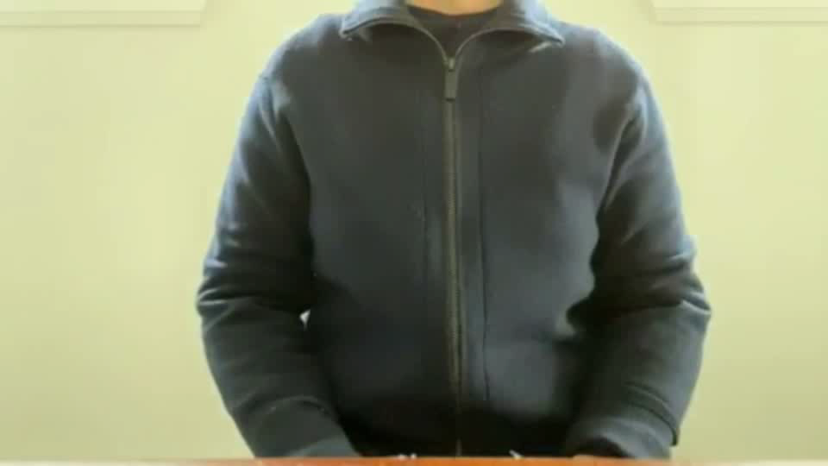
Run-time Example

Slide 6
Part A: Digit Detection
Goal: Creating a method for detecting digits on series of images

Slide 7
Neural Network Structure
Class | # of Training Images
Zero | 1368
One | 588
Two | 144
Three | 109
Four | 105
Five | 184
Six | 119
Seven | 324
Eight | 558
Nine | 493
Layer | Specific Type | Settings
0 | Random Flip
1 | Random Rotation
2 | Random Zoom
3 | Rescaling
4 | 2D Convolutional | 16 filters, 3 kernel size Relu activation
5 | 2D Max Pooling
6 | 2D Convolutional | 32 filters , 3 kernel size Relu activation
7 | 2D Max Pooling
8 | 2D Convolutional | 64filters , 3 kernel size Relu activation
9 | 2D Max Pooling
10 | Dropout | Rate of 0.2
11 | Dense Layer | 128 units Relu activation
12 | Dense Layer | 10 units Relu activation

Slide 8
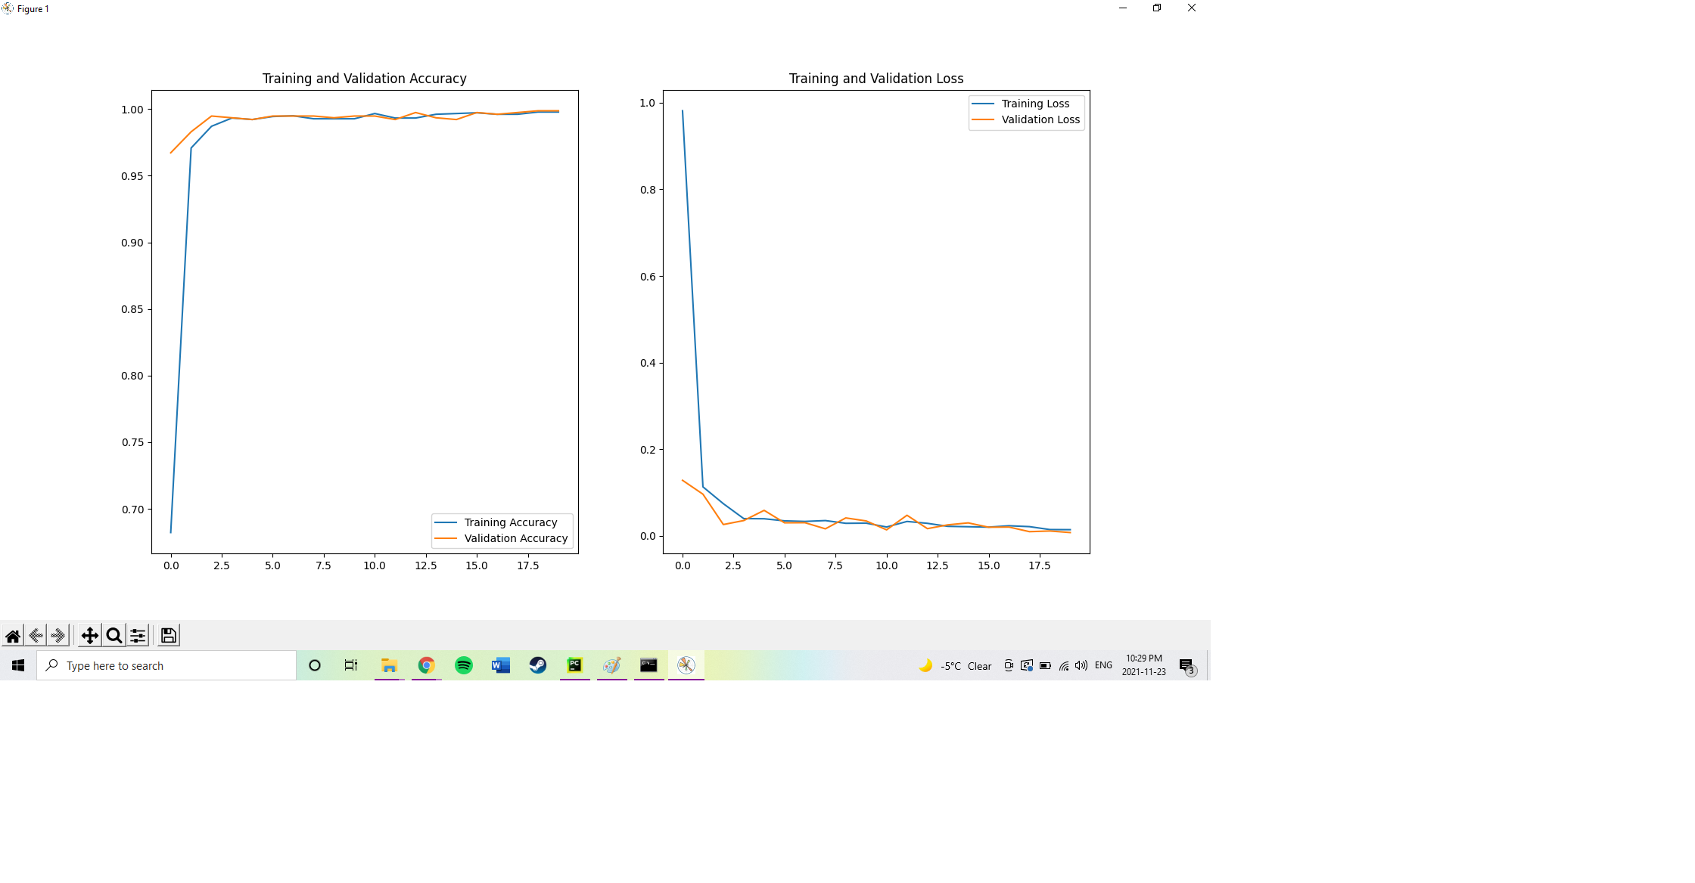
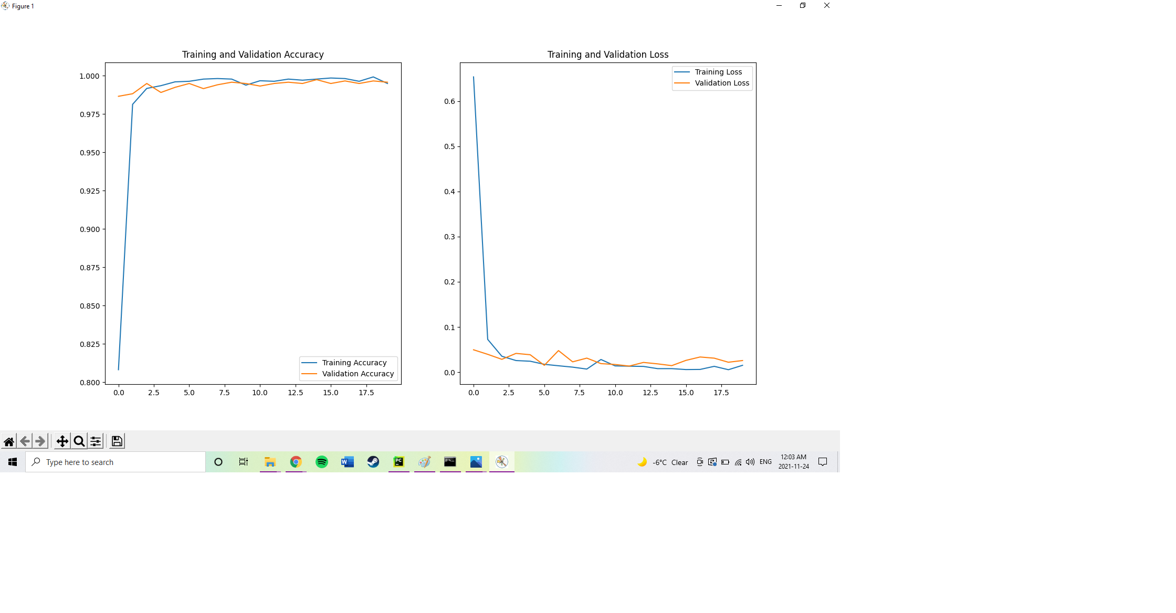
Neural Network Efficiency
First Training Iteration
Second Training Iteration

Slide 9
Method Steps
Request image name and open as frame
Gaussian Blur image with a kernel of (3, 3)
convert image to grayscale
Run canny edge detection on image with low_thresh=177 and high_thresh=204
Detect external contours on canny image with cv2.RETR_EXTERNAL and cv2.CHAIN_APPROX_NONE
Filter 4 largest contours by area
Sort contours by furthest left
For each contour found
Separate the contour's bounding box from the original image
Gaussian Blur image with a kernel of (5, 5)
Convert image to Grayscale
Run canny edge detection with a low_thresh=177 and high_thresh=204
Convert image to RBG
Resize image to 70w x 84h
Run TensorFlow Neural Network on image
return strongest prediction of number value
Output combined 4 strongest predictions in terminal

Slide 10
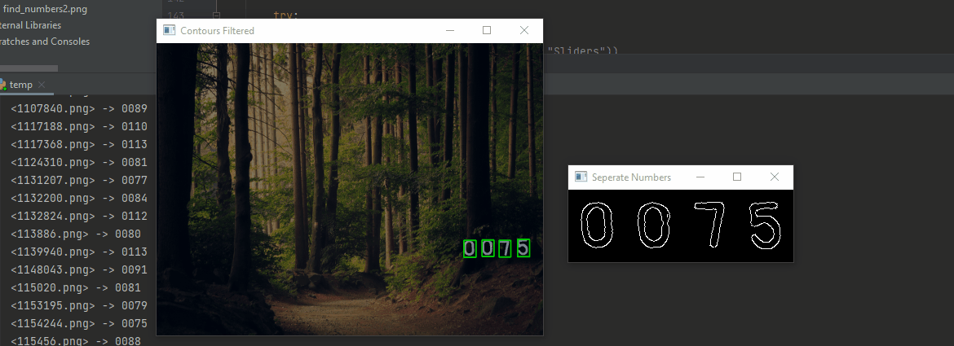
Run-time Example

Slide 11
Limitations
Correctly identified all 4 numbers
1294/1324 (97.734%)
Correctly identified all 4 non-corrupted numbers
1300/1324 (98.187%)
With the accuracy of the neural network, it appears that the error lies in incorrectly canny-edged images. Different threshvalues or a blurring method may provide an increase in accuracy

Slide 12

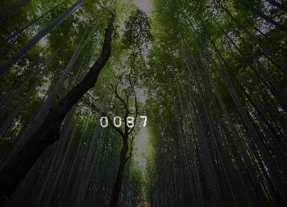
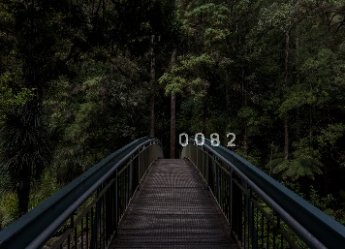
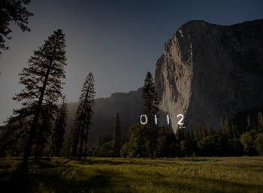
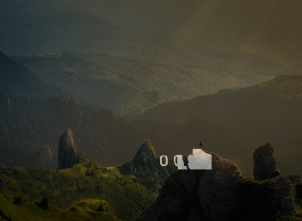
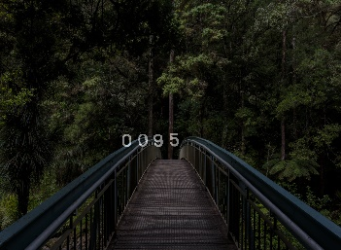
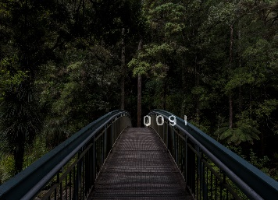
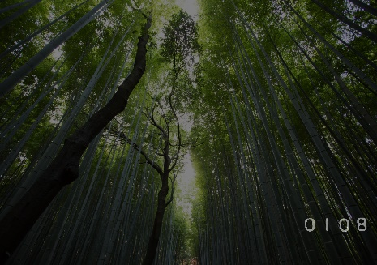
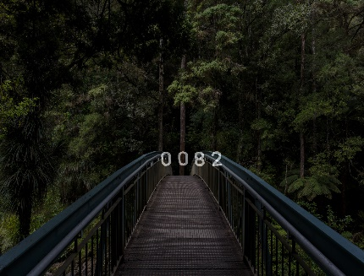

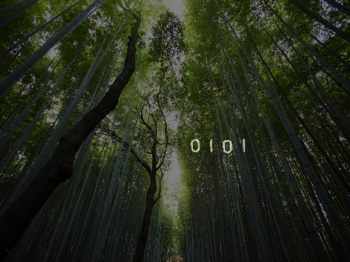
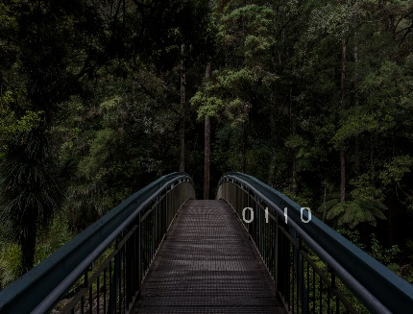
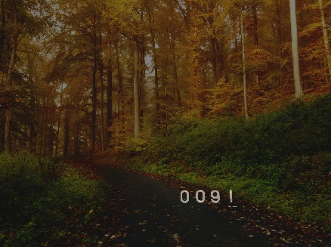
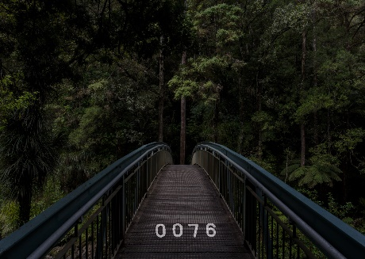
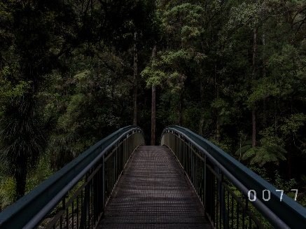
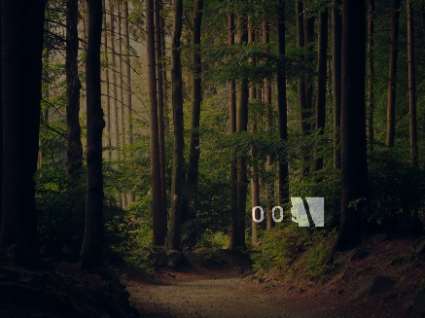
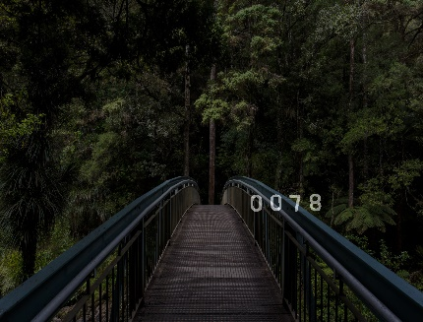

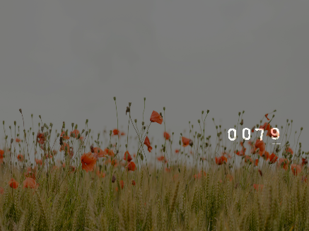

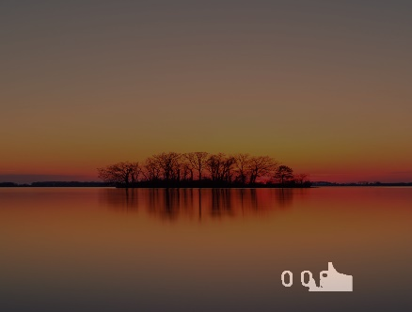
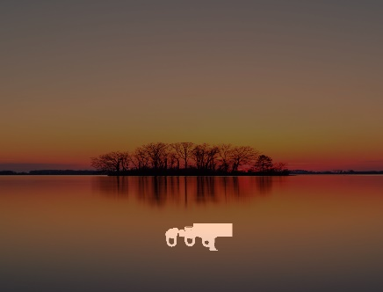
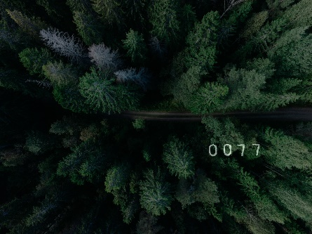
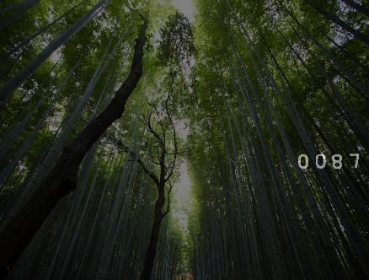
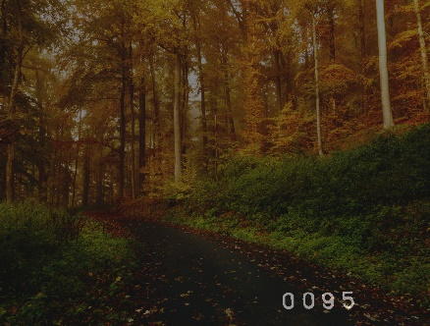
Images of Difficulty

Slide 13
Images of Difficulty

Slide 14
Images of Difficulty

Slide 15
Thank you!
Feel free to ask any questions.

Slide 16
References
https://www.tensorflow.org/tutorials/images/classification
TensorFlow. (2021, November 11). Image classification : Tensorflow Core. TensorFlow. Retrieved November 29, 2021, from https://www.tensorflow.org/tutorials/images/classification.
https://techvidvan.com/tutorials/hand-gesture-recognition-tensorflow-opencv/
Real-time hand gesture recognition using tensorflow & opencv. TechVidvan. (2021, July 21). Retrieved November 29, 2021, from https://techvidvan.com/tutorials/hand-gesture-recognition-tensorflow-opencv/.

